Slide 1
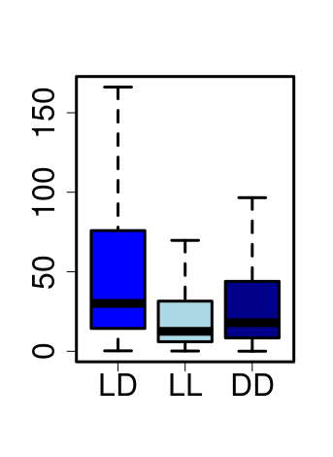
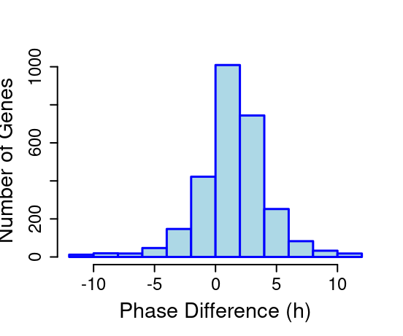
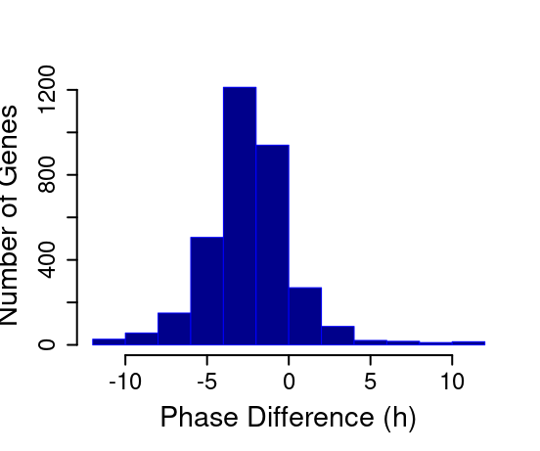
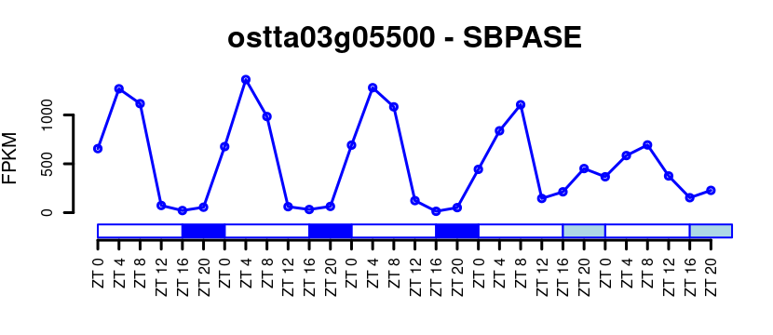
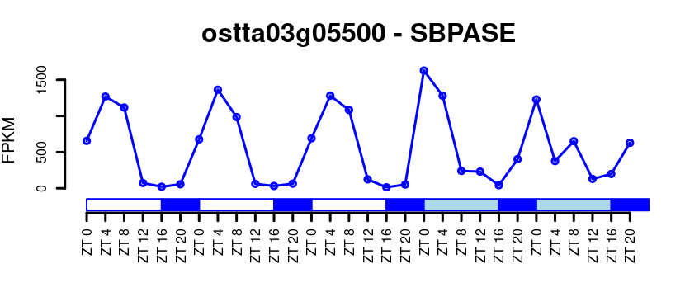
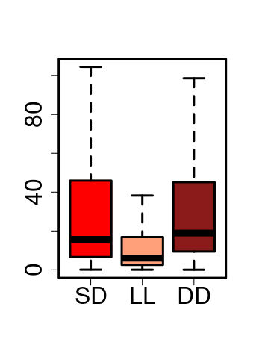
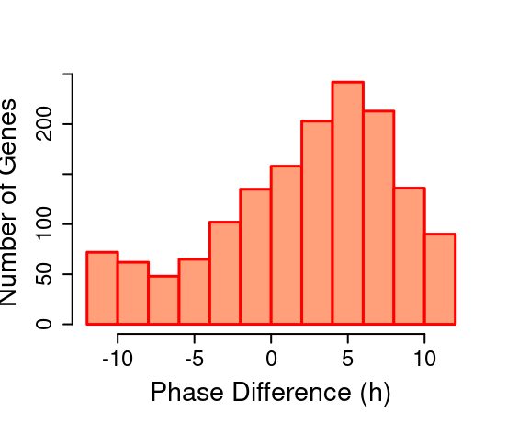
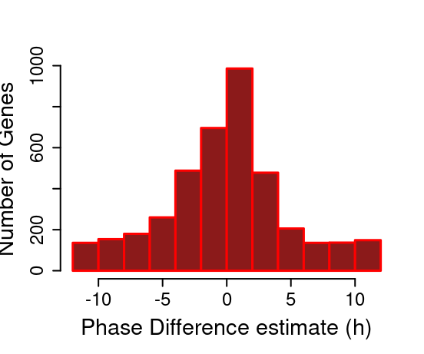
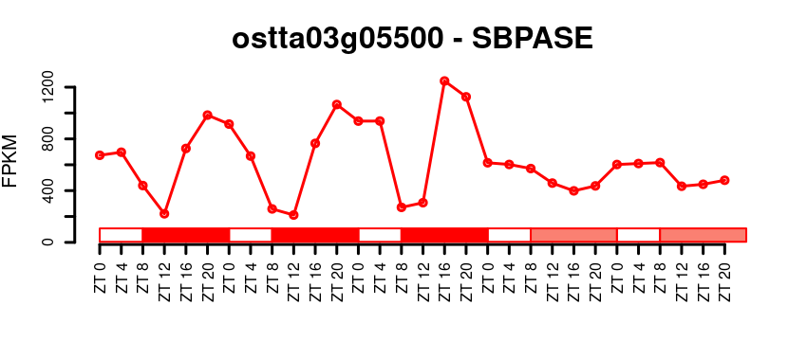
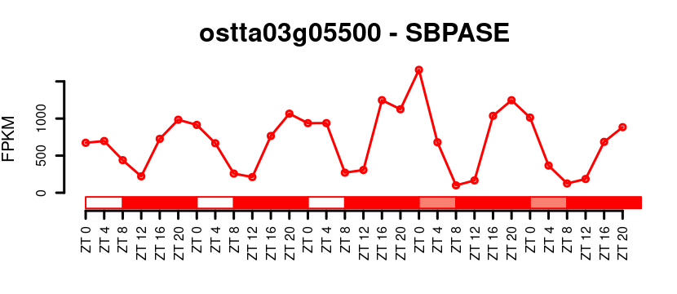
(A)
(B)
1200
800
Amplitude (FPKM)
800
Number of genes
Number of genes
400
400
0
0
-10
-5
0
5
10
-10
-5
0
5
10
(C)
Phase Difference (h)
Phase Difference (h)
ostta03g05500 - SBPase
ostta03g05500 - SBPase
1000
1000
FPKM
FPKM
0
0
(D)
(E)
200
800
Amplitude (FPKM)
Number of genes
Number of genes
100
400
0
0
-10
-5
0
5
10
-10
-5
0
5
10
(F)
Phase Difference (h)
Phase Difference (h)
ostta03g05500 - SBPase
ostta03g05500 - SBPase
1200
1500
FPKM
FPKM
600
750
0
0

